Slide 1

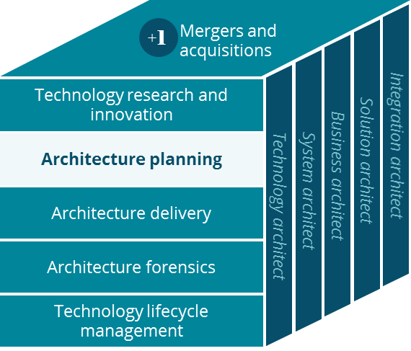
Meritain Business Canvas
Systems Planning

Slide 2
Business Canvas
Third Party Administration (Meritain)
Key Partnerships
Key Activities
Value Proposition
Customer Relationships
Customer Segment
Advocacy partners
Brokers
Design Health and ancillary plans
Integrate and manage multi-carrier networks
Cost containment
Service
discount negotiation
Plan sponsors
providers
Plan sponsors
(for self-insured
employer groups)
Provider network owners
Manage / admin claims
PBM services
Member (1.3M)
Flexible multi carrier network offering
Insurance companies
(for fully-insured
employer groups)
Key Resources
Channels
American Health Holding
HR of Service Operations, IT, Sales
e-mail /
e-pay
Software and licenses
Customizable service and administration package
Phone
Fax / IVR
Mail
Document & Payment fulfilment vendors
Technology infrastructure
Provider networks
Website
Face-to-face
Cost Structure
Revenue Streams
Business operations
IT infrastructure
American Health Holding
(Care management service)
Vendor services
Self-insured plan packages
Fully-insured plan packages
Ancillary products
(Stop Loss, PBM, HSA, Out-of network savings)
Cost containment shared cost savings

